Slide 1



Hackathon: Multimodal CTR Prediction Challenge
Jiepei Chen
Sunxiang Meng
Lu Peng
Xuanhao Yan
Hao Yang
Postgraduate, CityUHK (DG)
72405876, 72403219, 72401552, 72401459, 72405380@cityu-dg.edu.cn
Hackathon: Multimodal CTR Prediction Challenge
1

Slide 2
Content
1. Introduction and Relation Work
2. Multimodal Item Embedding
3. Multimodal CTR Prediction
4. Conclusion
Hackathon: Multimodal CTR Prediction Challenge
2

Slide 3
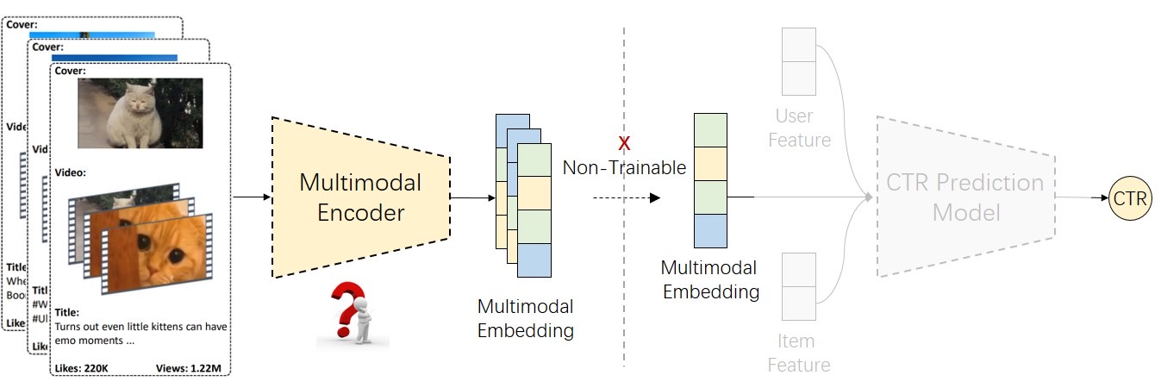
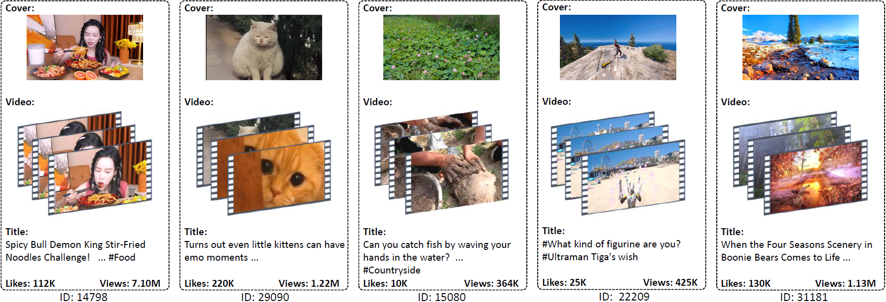
Introduction and Related Work
Dataset: We use the MicroLens-1M dataset released by Westlake University [1] for the MM-CTR Challenge. This dataset contains 1M users and 91K items, with detailed item content features (e.g., titles, covers).
Task 1: Participants are free to use open-source multimodal models, and design algorithms to extract multimodal embeddings. Extracted embeddings must be saved in a specified format and combined with other ID features as input for downstream CTR model evaluation.
Hackathon: Multimodal CTR Prediction Challenge
3

Slide 4
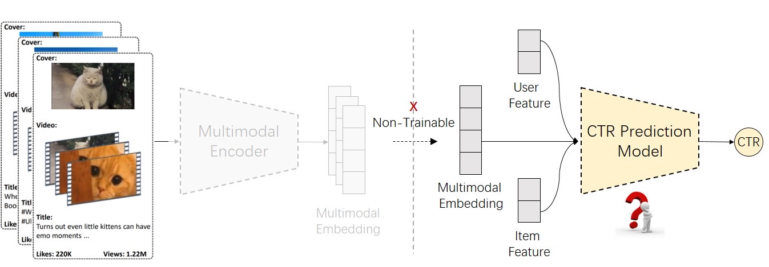
Introduction and Related Work
Task 2: It aims to explore what multimodal recommendation model can effectively leverage multimodal embedding features and achieve better performance. The organizers will provide extracted multimodal embeddings (from Task 1) and split user click data. Participants can improve the multimodal recommendation model based on the provided baseline model to enhance the CTR prediction results. Finally, participants will submit the predicted pCTR on the test set for competition.
Hackathon: Multimodal CTR Prediction Challenge
4

Slide 5
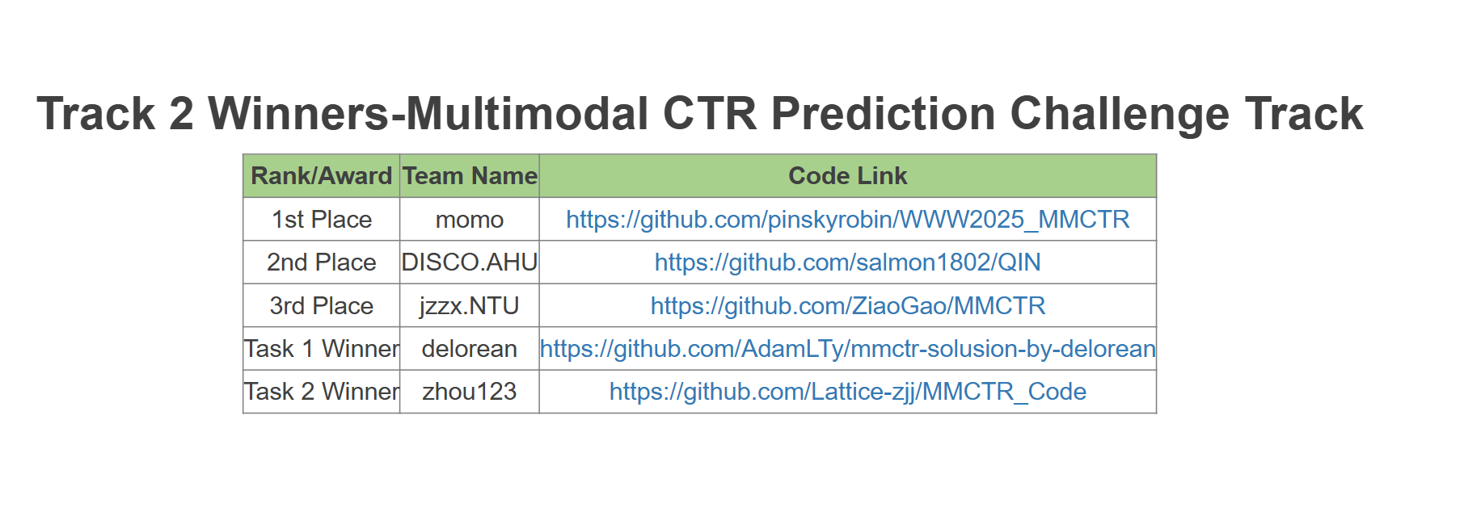
Introduction and Related Work
Hackathon: Multimodal CTR Prediction Challenge
5

Slide 6
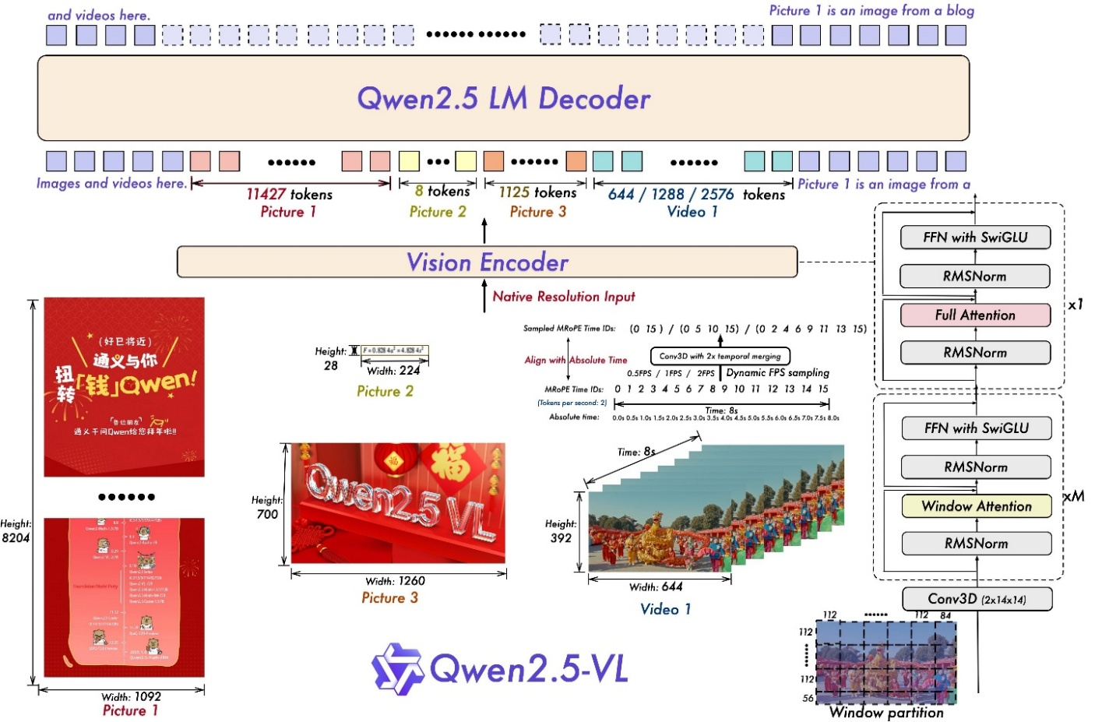
Multimodal Item Embedding
Delorean Solution
1.Qwen2.5-vl-7B to get embedding
using the second-to-last hidden layer with mean pooling to
obtain embeddings
2.Using PCA to reduce the dimensionality of embeddings
3.Using the default settings of the DIN recommendation model
Hackathon: Multimodal CTR Prediction Challenge
6

Slide 7
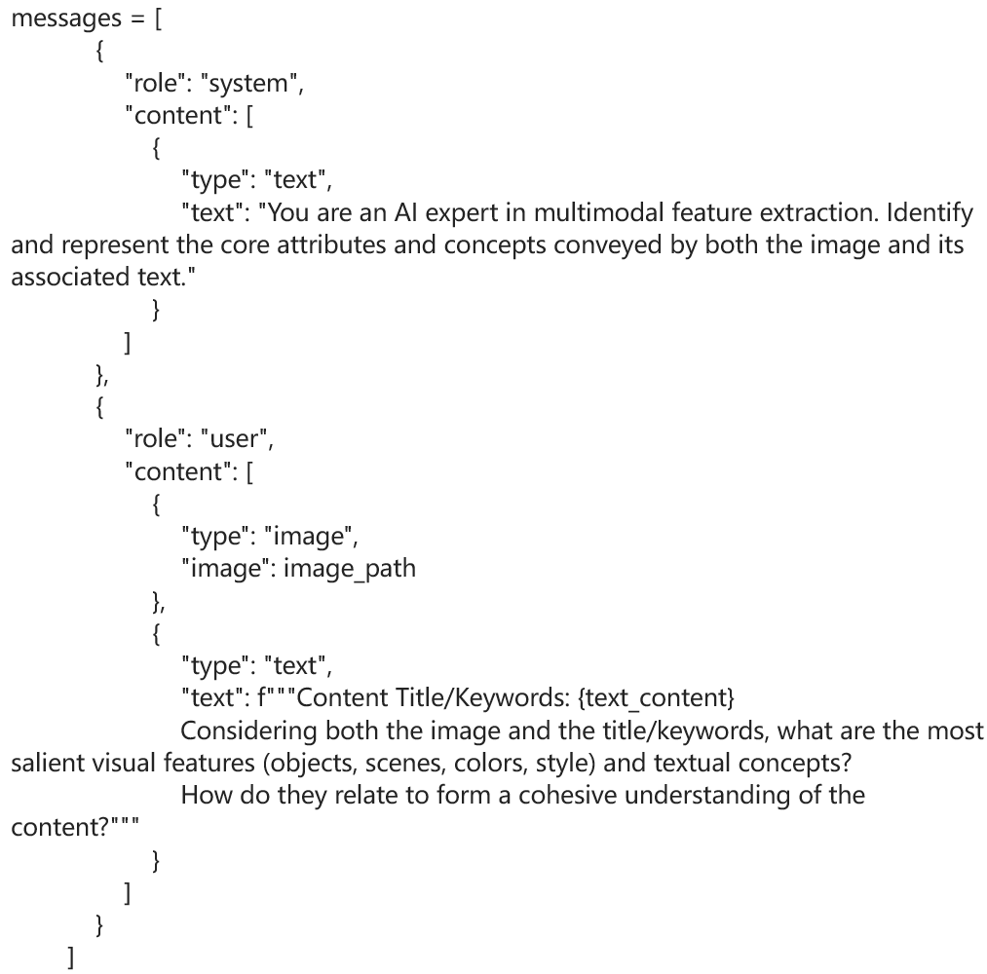
Multimodal Item Embedding
Original Prompt
New Prompt
Please systematically analyze the video from the following dimensions, providing detailed descriptions for each:
1.Topic Analysis: What is the main content category and specific topic of this video? Which field does it belong to?
··· Tedious!!!
48.Textual Summarization and Abstraction: Can the video content be effectively summarized or abstracted into text for quick understanding or reference in other media? How can the content be condensed and refined?
Please ensure your analysis is comprehensive, specific, and insightful, providing sufficiently detailed descriptions for each dimension.
Hackathon: Multimodal CTR Prediction Challenge
7

Slide 8
Multimodal Item Embedding
Hackathon: Multimodal CTR Prediction Challenge
8

Slide 9
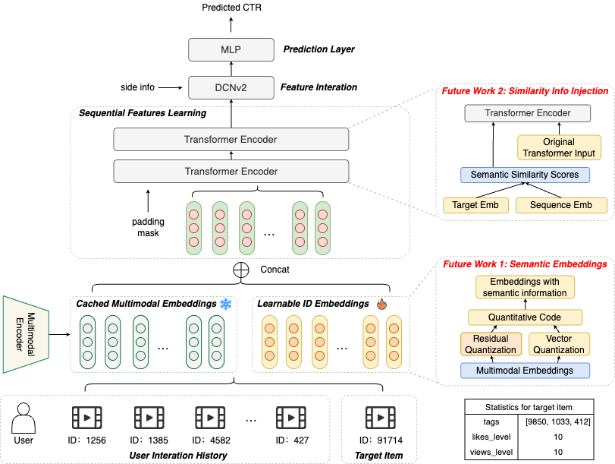
Multimodal CTR Prediction 1st Place Solution
The model integrates four key components:
Embedding Layer that converts input features (e.g., item IDs, tags) into dense embeddings and concatenates them with frozen multimodal embeddings.
Sequential Feature Learning Module using Transformer to capture temporal patterns, combining short-term and long-term user interests
Feature Interaction Module leveraging DCNv2 to model explicit and high-order feature interactions through cross layers and a deep MLP
Prediction Layer with a 2-layer MLP and sigmoid activation for CTR prediction.
https://github.com/pinskyrobin/WWW2025_MMCTR?tab=readme-ov-file
Hackathon: Multimodal CTR Prediction Challenge
9

Slide 10
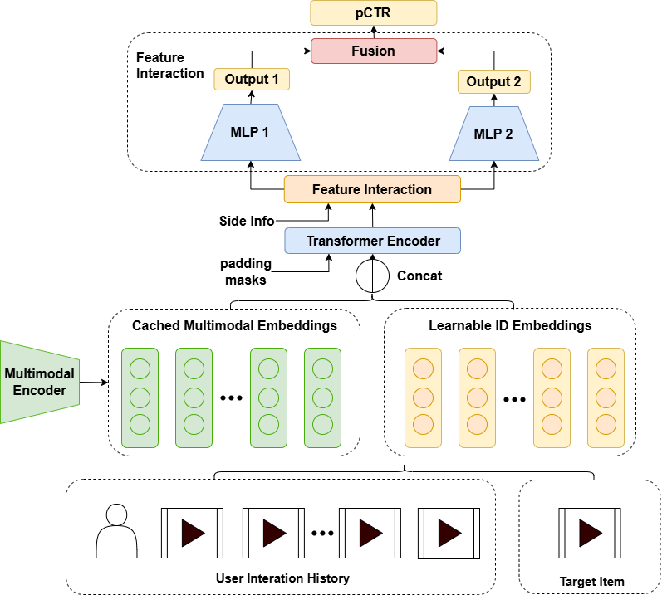
Multimodal CTR Prediction Our Solution
Through two MLP streams and bilinear fusion, FinalMLP achieves more flexible feature interaction learning.
FinalMLP applies feature selection mechanism to provide differentiated feature inputs for the two MLP streams, which enhancing the model's expression ability. In contrast, DCNv2 simply concatenates the outputs of CrossNet and MLP. FinalMLP captures high-dimension interactions between the outputs of the two streams via bilinear fusion.
Mao K, Zhu J, Su L, et al. FinalMLP: an enhanced two-stream MLP model for CTR prediction[C]//Proceedings of the AAAI conference on artificial intelligence. 2023, 37(4): 4552-4560.
Hackathon: Multimodal CTR Prediction Challenge
10

Slide 11
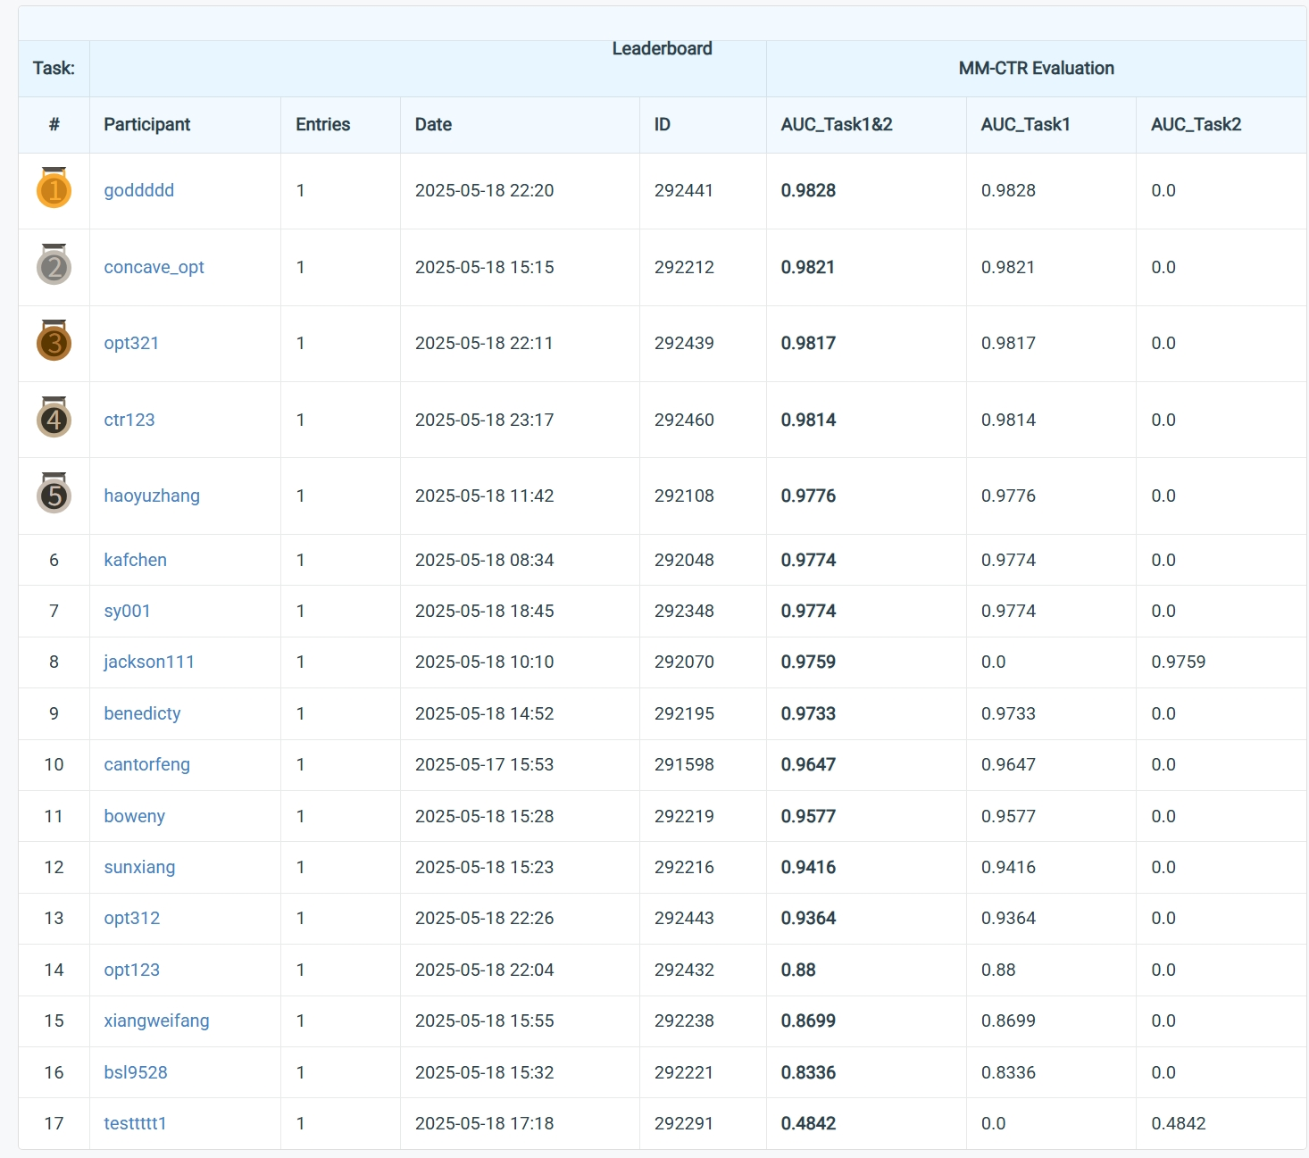
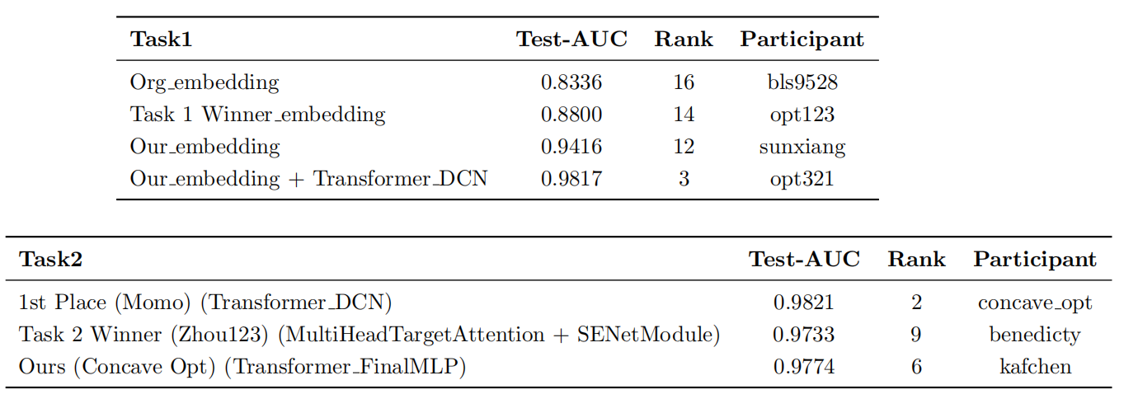
Conclusion
Hackathon: Multimodal CTR Prediction Challenge
11

